Slide 1
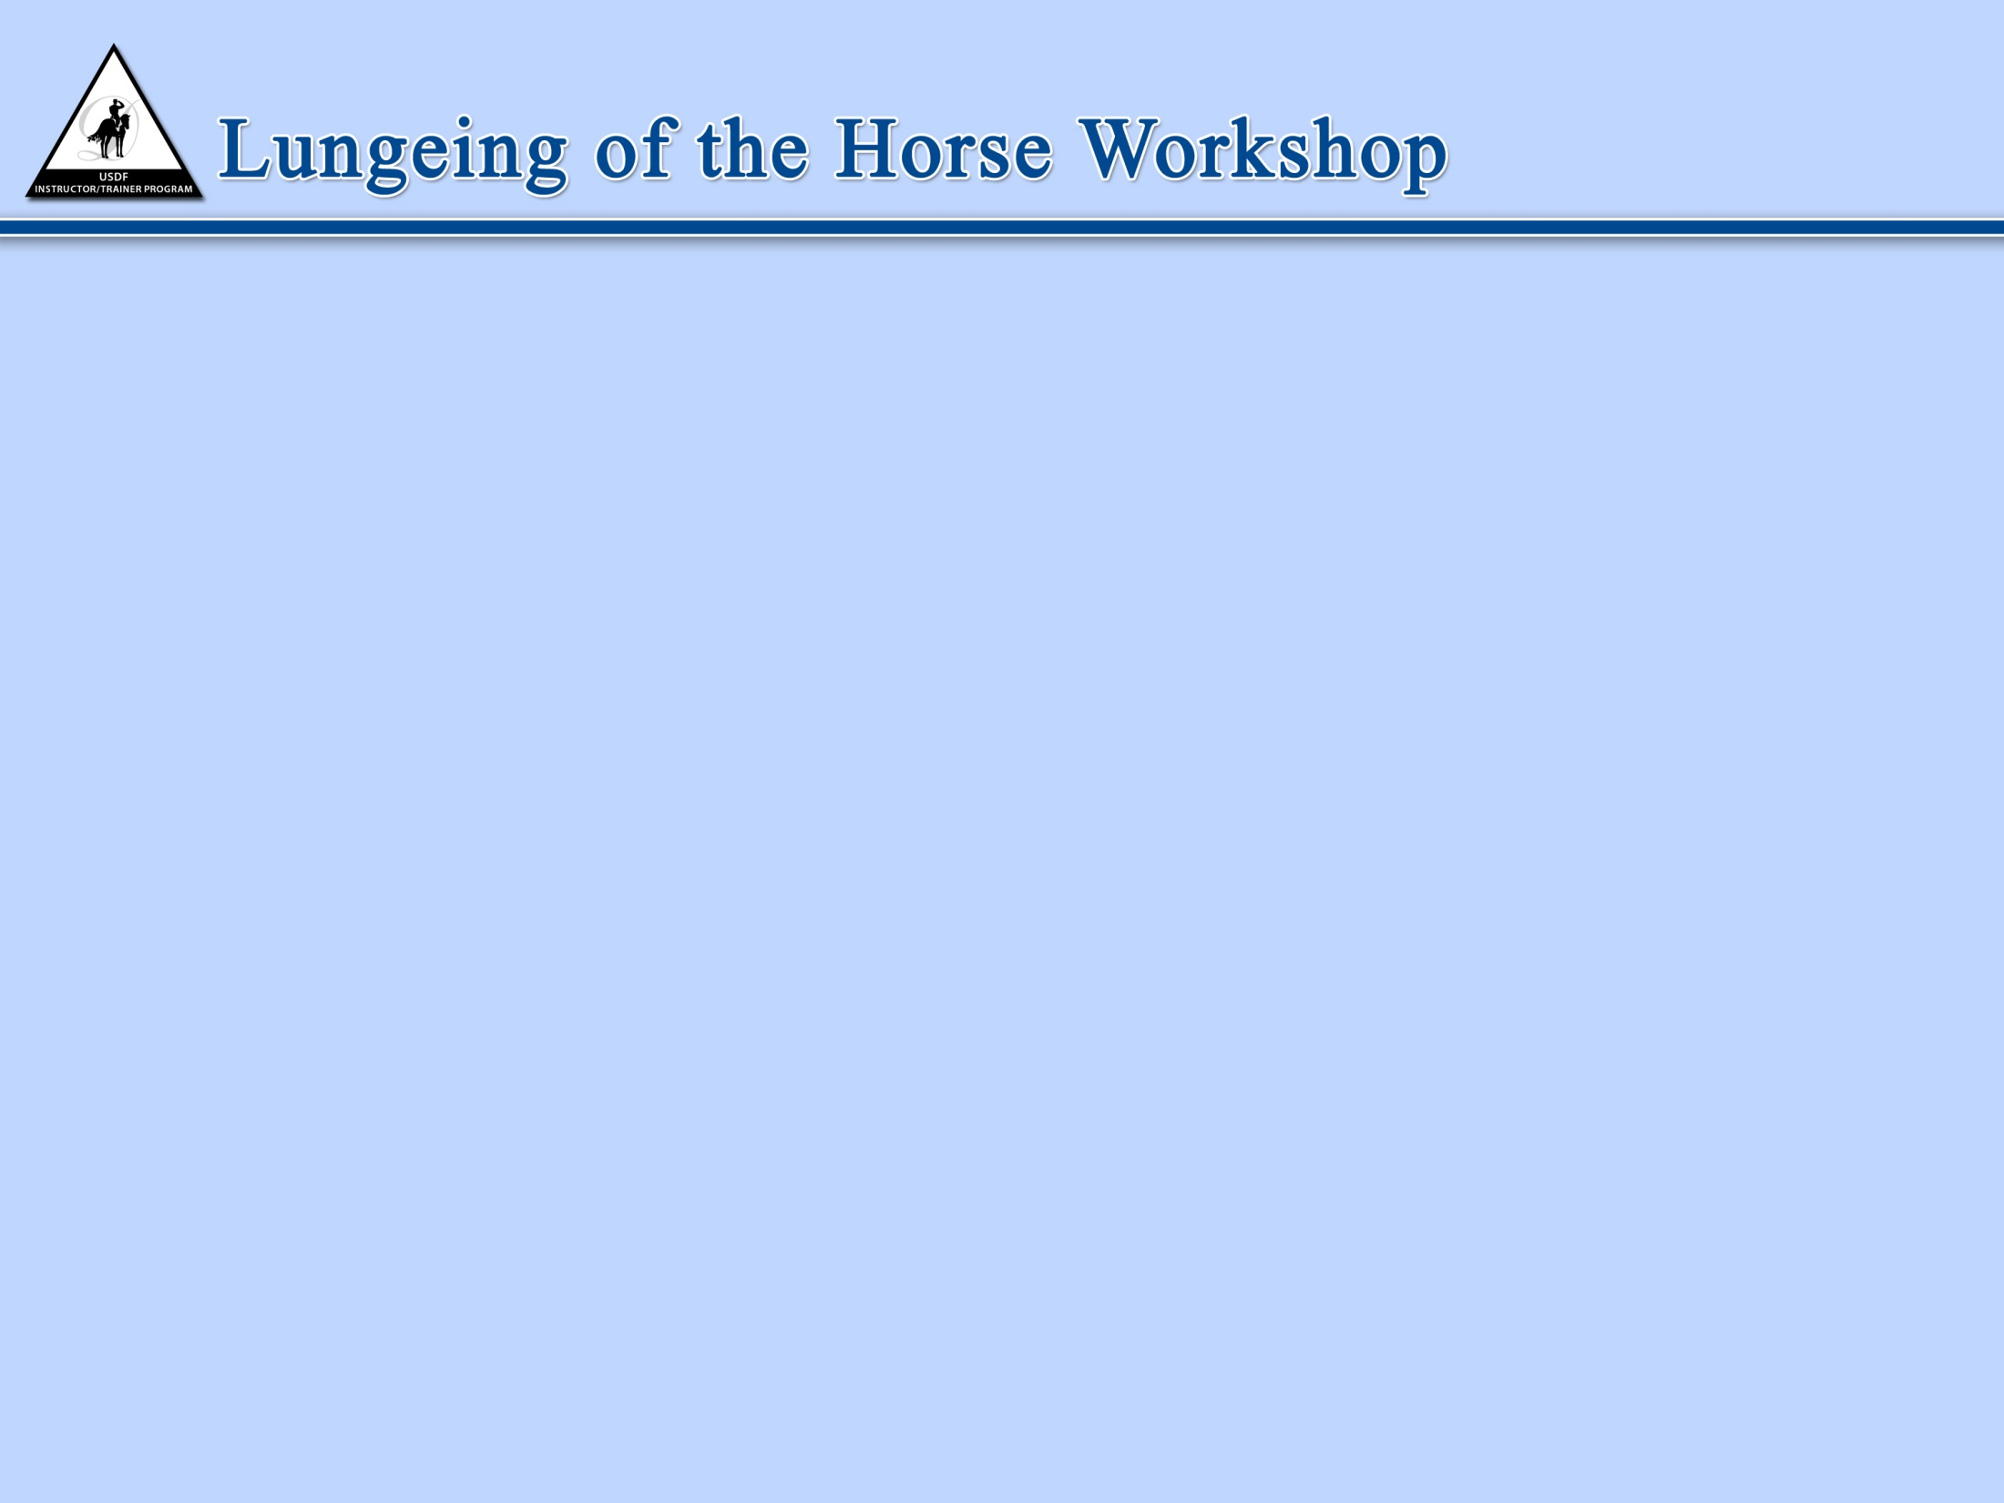

USDF INSTRUCTOR/TRAINER
DEVELOPMENT PROGRAM
Dressage Development Seminar
LUNGEING

Slide 2
GOAL OF LUNGEING SEMINAR
DRESSAGE DEVELOPMENT SEMINAR
To teach correct lungeing principles and techniques for training the horse and rider

Slide 3
  OBJECTIVES OF LUNGEING THE HORSE
DRESSAGE DEVELOPMENT SEMINAR
    To promote Safety – demonstrate correct use and fit of lungeing equipment (refer to the USDF Lungeing Manual).
To teach correct and safe technique in lungeing the horse.
To understand the relationship between lungeing and the development of the horse; evaluation of the gaits and how to improve them.
To assess the horse in terms of the appropriate work on the lunge to further training.

Slide 4
SAFETY REQUIREMENTS
DRESSAGE DEVELOPMENT SEMINAR
    Appropriate Attire
    Location
    Correct and Safe Equipment
    Correct Lungeing Technique
    Correct warm-up

Slide 5
REASONS TO LUNGE
DRESSAGE DEVELOPMENT SEMINAR
    Training of young horses.
    Supplementing the training program.
    Improving muscle development (conformational shortcomings).
    Retraining horses who lack some elements of the Pyramid of Training.
    Exercising horses that cannot be ridden.
    As a preparation for work in-hand.

Slide 6
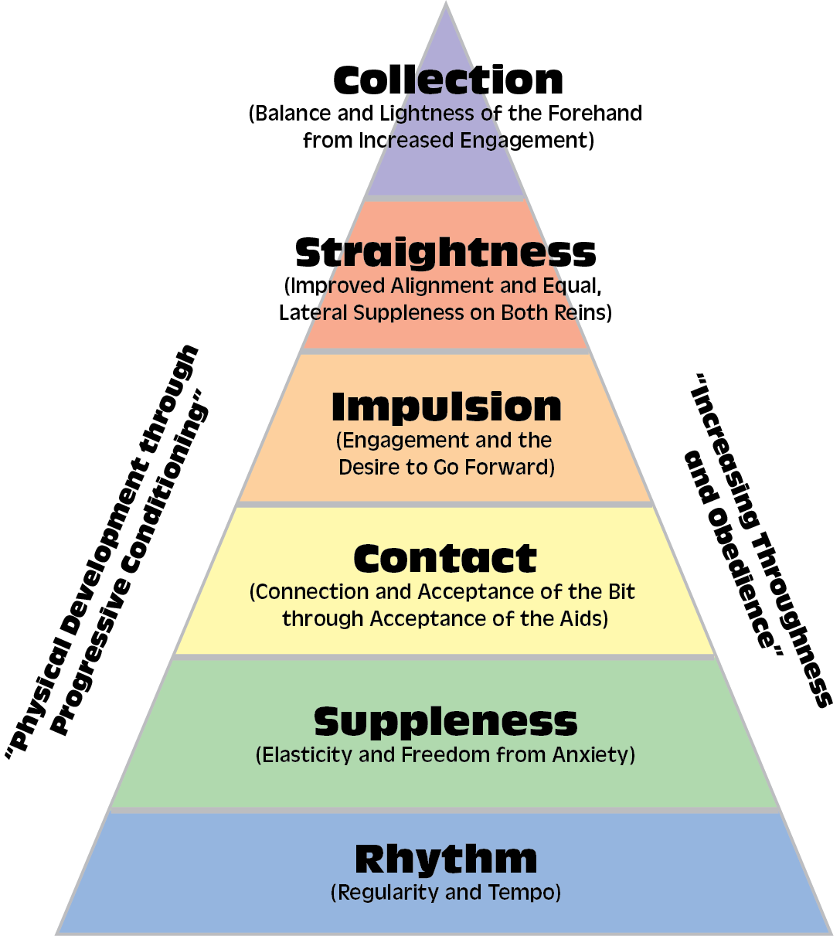
DRESSAGE DEVELOPMENT SEMINAR

Slide 7
DRESSAGE DEVELOPMENT SEMINAR
“Lungeing, just like riding and teaching, is a skill that must be cultivated through hours of long practice.” -Lendon Gray

Slide 8
  ASSESS THE HORSE USING THE FOLLOWING CRITERIA
DRESSAGE DEVELOPMENT SEMINAR
Pyramid of Training – as it applies to the level of the
horse
Concept of the horse being in front of the leg and seat, on the aids and how that relates to the circle of the aids when lungeing
Basic training and balance appropriate to the level
Quality of gaits; including rhythm, tempo, balance

Slide 9
  THINGS TO OBSERVE
DRESSAGE DEVELOPMENT SEMINAR
Lungeing correctly allows you to “ride from the ground”. You can set the tone for your ride by creating a horse who is relaxed, supple and focused before the rider mounts.

Slide 10
  THINGS TO OBSERVE
DRESSAGE DEVELOPMENT SEMINAR
Muscle type
  Overall muscling and development of the topline
  Correct use of the muscles
Gaits/Movement
  Soundness
  Levelness
  Evenness
Conformation and straightness

Slide 11
DRESSAGE DEVELOPMENT SEMINAR
THINGS TO OBSERVE
Stiff and hollow side
  Horse’s natural/default alignment
Tracking of the hind legs
Use of the back
Degrees of lateral/longitudinal suppleness
Contact and connection

Slide 12
DRESSAGE DEVELOPMENT SEMINAR
REMINDERS
Lungeing can serve to address various aspects as you warm-up the horse; preparing him to carry weight on his back before having to balance a rider.
Lungeing can serve as a working session unto itself.

Slide 13
DRESSAGE DEVELOPMENT SEMINAR
END LUNGEING OF THE HORSE

Slide 14
  OBJECTIVES OF LUNGEING THE RIDER
DRESSAGE DEVELOPMENT SEMINAR
Demonstrate correct use and fit of lungeing equipment. (Refer to USDF the Lungeing Manual)
Demonstrate correct and safe technique in lungeing the horse and rider.
Review correct rider position with emphasis placed on rider’s alignment and balance.
Assess rider position and implement appropriate seat lesson exercises and methodology.
At Training - First Level: Develop the rider’s position, balance, and independence of the aids. At Second Level: Further develop feel, timing, and effect of the aids through appropriate exercises.

Slide 15
  ADDITIONAL OBJECTIVES
DRESSAGE DEVELOPMENT SEMINAR
Development of balance for a safe and secure seat
Development of classical seat and position
Independence of seat, leg and hand
Development of feel
Communication with the horse

Slide 16
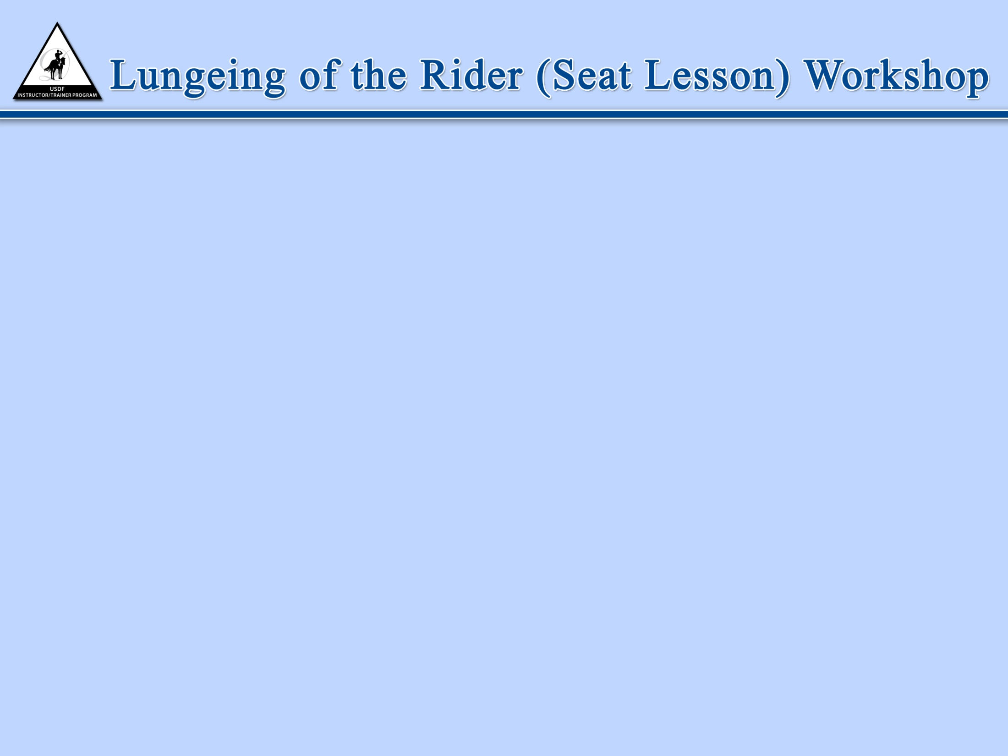
SAFETY REQUIREMENTS
DRESSAGE DEVELOPMENT SEMINAR
    Appropriate Attire for both the instructor and the rider
    Location
    Correct and Safe Equipment
    Correct Lungeing Technique
    Correct warm-up of the horse
© United States Dressage Federation

Slide 17
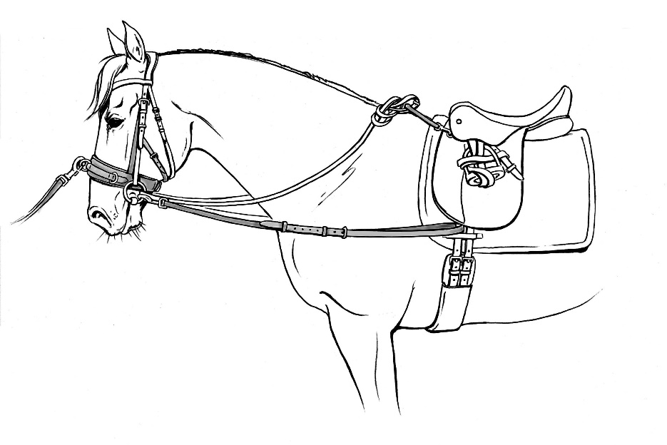
SAFETY REQUIREMENTS
DRESSAGE DEVELOPMENT SEMINAR
Preparation of equipment
  Safety strap use
  Detach side reins while mounting/dismounting
  How and when to do work without stirrups
© United States Dressage Federation

Slide 18
SUITABILITY OF HORSE
DRESSAGE DEVELOPMENT SEMINAR
For a less experienced rider:
  Quiet, moderate gaits and appropriate size
  Keep student on same horse each lesson when possible
For advanced riders:
  Add variety of horses with varying gaits
For all riders:
  Horse must be experienced, safe, steady, well accustomed to being lunged in side-reins, and comfortable with the rider’s movements associated with lungeing exercises.
  © United States Dressage Federation

Slide 19
DRESSAGE DEVELOPMENT SEMINAR
RIDER WARM-UP PRIOR TO MOUNTING
  Cold stretching should be avoided. Have the rider perform light movement-based exercises before stretching. Depending upon fitness level this could include walking, skipping, jumping jacks, lunges etc.
  Light stretching should be encouraged when the rider is warm, including neck, spine, hips, arms and legs.
  Research exercise theory and begin to develop a series of exercises to use with your students. When working with a new student in a seat lesson environment this information should be incorporated into your plan to prevent injury.
  Be able to make adjustments for fitness level and previous injuries.
  © United States Dressage Federation

Slide 20
DRESSAGE DEVELOPMENT SEMINAR
WARM-UP OF RIDER WHEN MOUNTED
  Help the rider to become aware of their balance, seat, legs and hands.
  Use breathing exercises to develop initial balance, alignment and relaxation.
POINTS TO ASSESS
  Where is the rider deviating from a classical seat?
  Assessing the seat at the halt will identify alignment specific issues.
  Balance issues will become evident as the horse is in motion.
  Identify if the misalignment is the primary issue or if it is secondary to a balance issue.
  © United States Dressage Federation

Slide 21
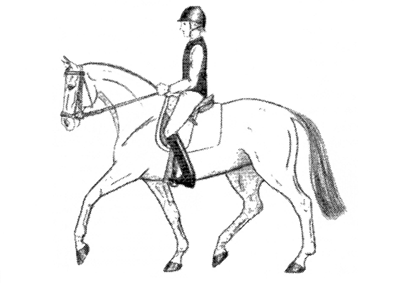
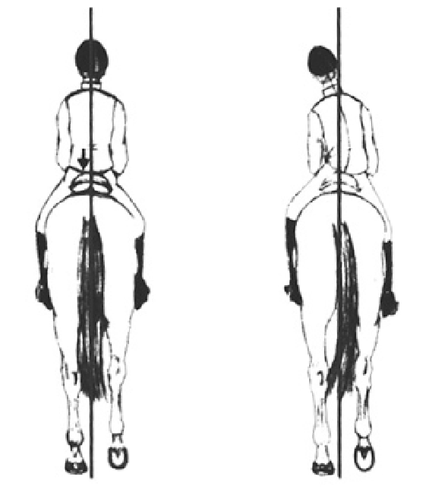
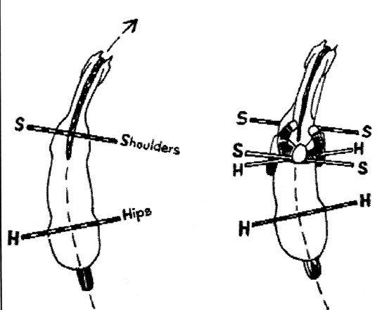
DRESSAGE DEVELOPMENT SEMINAR
Position and Alignment

Slide 22
DRESSAGE DEVELOPMENT SEMINAR
CONSIDERATIONS FOR SEAT LESSON
  Level and condition of rider (physical limitations, old injuries, joint replacements, etc.)
  Duration
  Suitability of horse
  Equipment
  Mounting
  Initial assessment
  Exercises to be used
  Summary
  © United States Dressage Federation

Slide 23
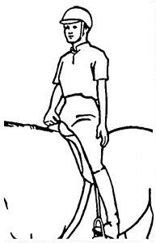
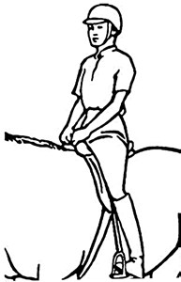
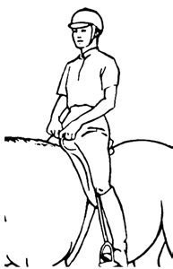
Basic Position
DRESSAGE DEVELOPMENT SEMINAR
Variations
Hold pommel or safety
strap with both hands
Inside hand hangs down
Both hands hang down
One finger of each hand
holds pommel or safety
strap
One finger of outside hand only holds pommel or safety strap

Slide 24
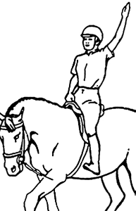
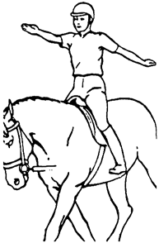
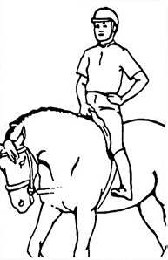
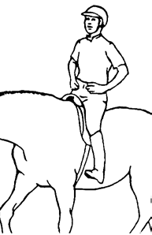
DRESSAGE DEVELOPMENT SEMINAR
Exercises to improve balance, suppleness and to develop independent
seat and hands
Inside arm circles backwards
Windmill both arms
Inside hand on hip
    Advanced variation: outside hand in rein holding position
Both hands on hips

Slide 25
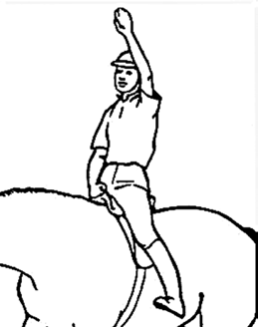
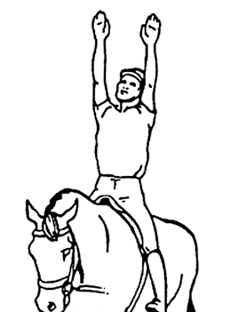
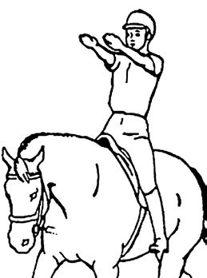
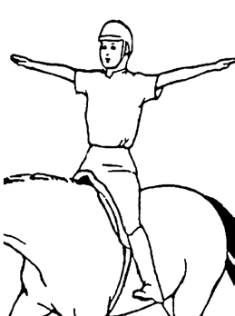
DRESSAGE DEVELOPMENT SEMINAR
Exercises to improve balance, suppleness and to develop
Independent seat and hands
Can be performed with inside arm or both arms:
  Arm straight up
  Arm forward at shoulder level
  Arm sideways at shoulder height

Slide 26
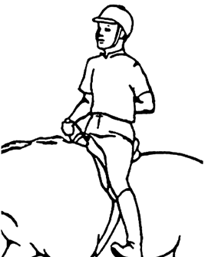
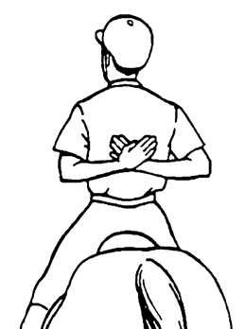
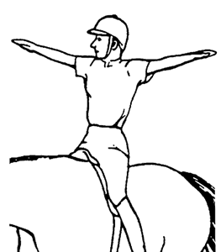
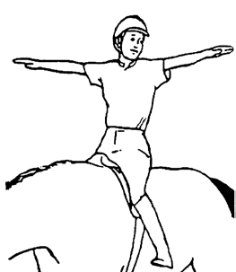
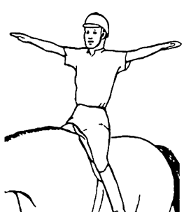
DRESSAGE DEVELOPMENT SEMINAR
Exercises to improve balance, suppleness and to develop independent
seat and hands
Inside or both arms behind back
Arms out to the side
  rider looks center, left, and right

Slide 27
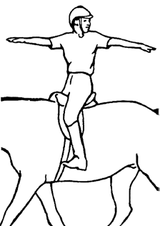
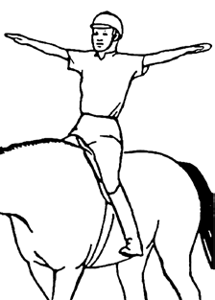
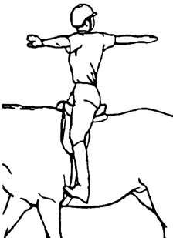
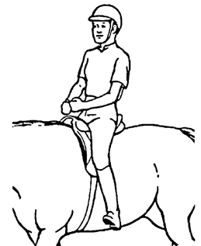
DRESSAGE SEMINAR
Exercises to improve balance, suppleness and to develop independent
seat and hands
Rider rotates from waist, left and right
Rein-Holding Position Exercises
Inside hand rein position, outside hand on pommel or safety strap
Both hands in rein holding position
Supple fingers by making fist and releasing as though wringing water out of a sponge

Slide 28
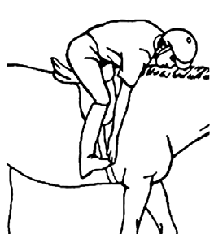
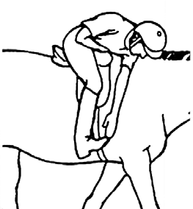
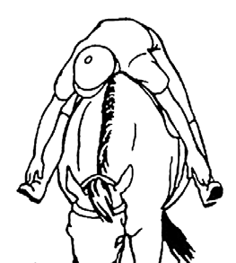
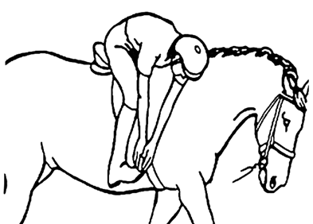
DRESSAGE DEVELOPMENT SEMINAR
Exercises to improve balance, suppleness and to develop independent
seat and hands
Toe Touches:
Same side
Opposite side
Both hands to one side
Both toes

Slide 29
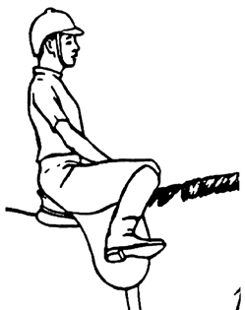
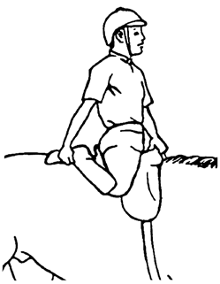
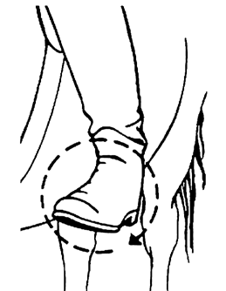
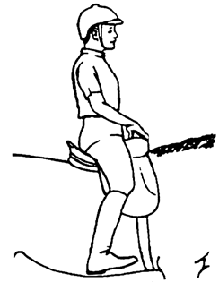
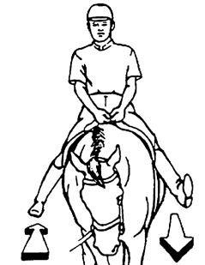
DRESSAGE DEVELOPMENT SEMINAR
Exercises for the seat and leg
Knees up/down
Mounted quad stretch
Swing legs alternatively backwards and forwards from hip
Rotate ankles

Slide 30
USDF INSTRUCTOR/TRAINER
DEVELOPMENT PROGRAM
Dressage Development Seminar
LUNGEING
www.usdf.org
instructorcertification@usdf.org

